Slide 1
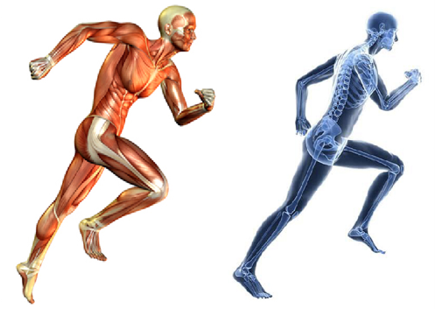

LOCOMOTION AND MOVEMENT

Slide 2
What is locomotion?

Slide 3
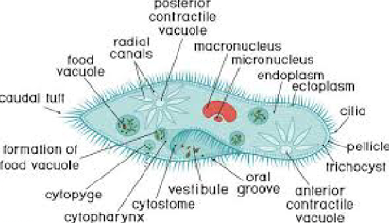
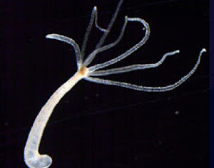
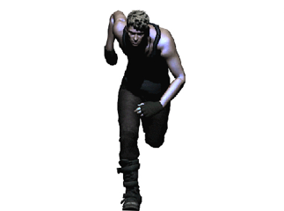
Locomotion & movement are interlinked. E.g.

Slide 4
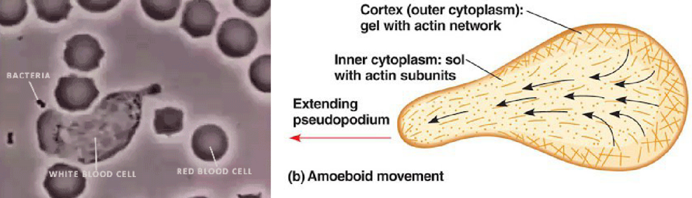
AMOEBOID MOVEMNT

Slide 5
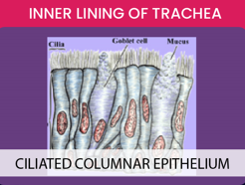
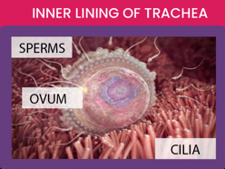
CILIARY MOVEMNT

Slide 6
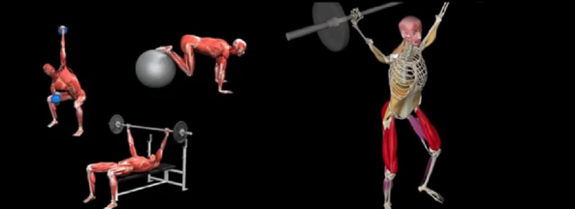
MUSCULAR MOVEMNT

Slide 7
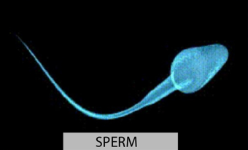
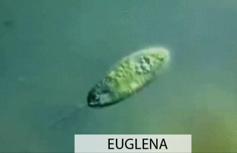

Slide 8
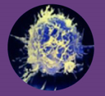


AMOEBOID MOVEMNT
By pseudopodia formed by Streaming of protoplasm.
Cytoskeletal elements like microfilaments also help for this.
E.g. Macrophages & leucocytes.
CILIARY MOVEMNT
By cilia.
E.g. cilia in trachea (to remove foreign substances)
& oviducts (for passage of ova)
MUSCULAR MOVEMNT
By muscles.
E.g. movements of limbs, tongue, jaw etc.

Slide 9
HUMAN MUSCULAR SYSTEM

Slide 10
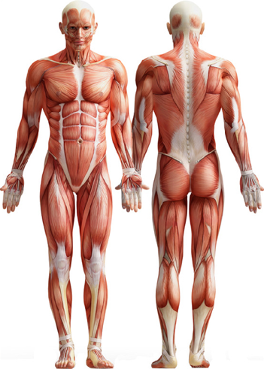

Slide 11
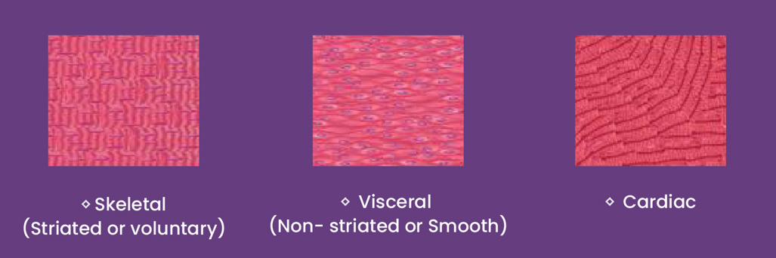
Based on location, muscles are 3 types:
Types of Muscles

Slide 12
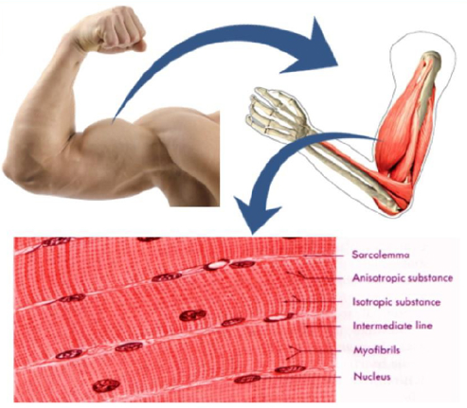
SKELETAL (STRIATED) MUSCLES

Slide 13
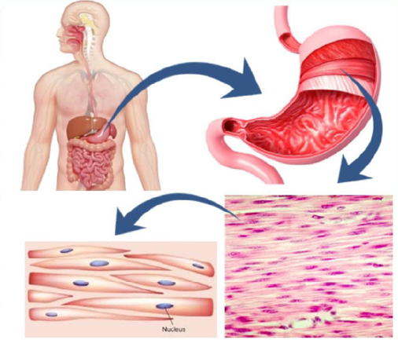
VISCERAL (SMOOTH) MUSCLES

Slide 14
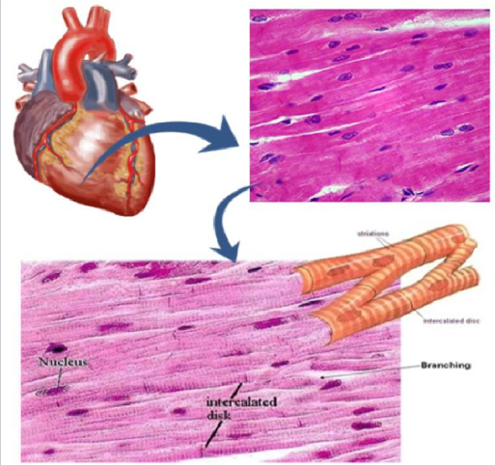
CARDIAC MUSCLES

Slide 15
COMPARISON OF MUSCLES: AT A GLANCE
SKELETAL (STRIATED)
MUSCLES
VISCERAL (SMOOTH)
MUSCLES
CARDIAC
MUSCLES
Attached to skeleton
Striations present
Voluntary
Rich blood supply
Fatigue muscle
Multinucleate (syncytium)
More mitochondria
In visceral organs
Striations absent
Involuntary
Poor blood supply
Non-Fatigue
Uninucleate
Less mitochondria
In heart wall
Striations present
Involuntary
Rich blood supply
Non-Fatigue
Uninucleate
More mitochondria

Slide 16
Class Assignment
1. Assertion : Cilia in Paramecium are known to have dual function.
Reason: In Paramecium cilia helps in the movement of food through cytopharynx and locomotion as well.
1. Both assertion and reason are true and reason is the correct explanation of assertion.
2. Both assertion and reason are true but reason is not the correct explanation of assertion.
3. Assertion is true but reason is false.
4. Both assertion and reason are false.

Slide 17
2. Which out of following does not exhibit amoeboid movement?
1. Macrophages 2. Leucocytes
3. Erythrocytes 4. Amoeba
3. The passage of ova through the female reproductive tract is an example of __________ movement.
1. Ciliary 2. amoeboid
3. muscular 4. both 1 and 2
4. Co-ordinated movement of ______ in trachea helps in removing inhaled dust particles.
1. flagella 2. cilia 3. protoplasm 4. microfilaments

Slide 18
5. Muscles located in digestive tract are
1. Striated muscles 2. Visceral muscles
3. smooth muscles 4. both 2 and 3
6. Which amongst the following muscles are striated in appearance?
1. Skeletal 2. Cardiac
3. Smooth 4. Both 1 and 2
7. Cardiac muscles are
1. non-striated 2. smooth
3. branched 4. visceral

Slide 19
STRUCTURE OF STRIATED MUSCLE

Slide 20
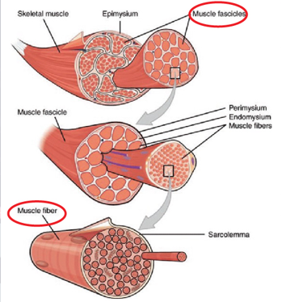
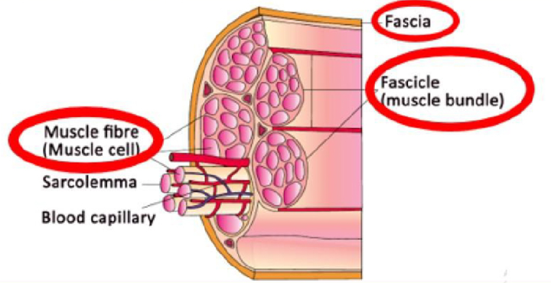

Slide 21
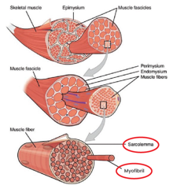
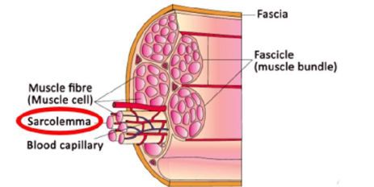

Slide 22
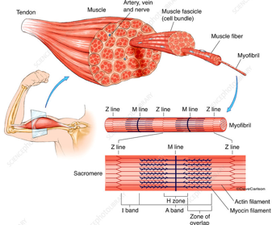

Slide 23
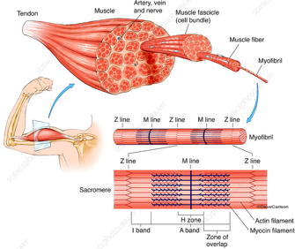
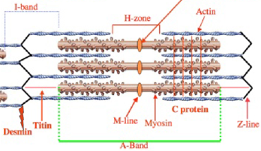

Slide 24
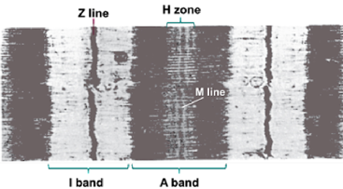

Slide 25
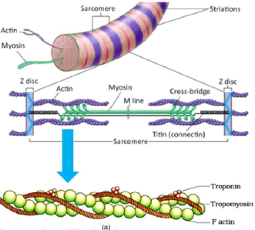
1. ACTIN

Slide 26
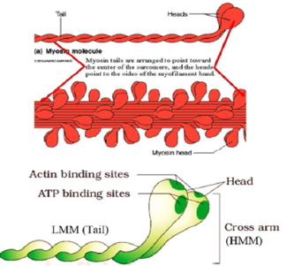
2. MYOSIN

Slide 27
MECHANISM OF MUSCLE CONTRACTION

Slide 28
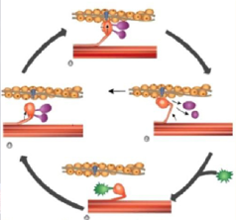
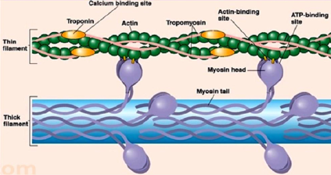

Slide 29
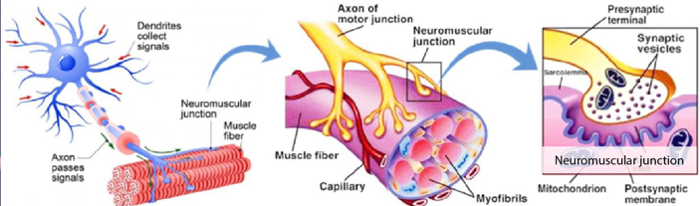
STEPS

Slide 30
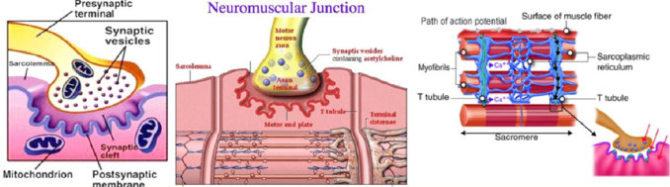

Slide 31
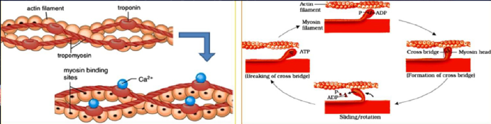

Slide 32
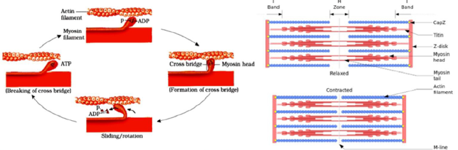

Slide 33
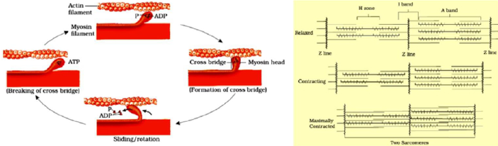

Slide 34
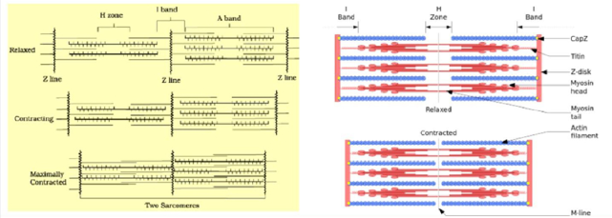

Slide 35
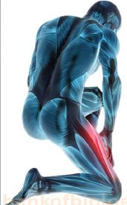
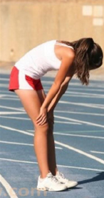
MUSCLE FATIGUE

Slide 36
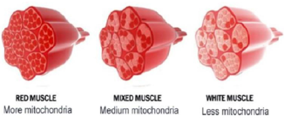
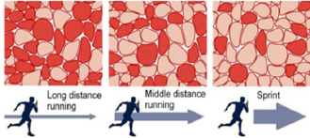
RED (AEROBIC) MUSCLE FIBERS
WHITE MUSCLE FIBERS

Slide 37
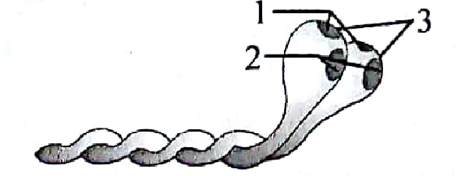
8. Myofibrils are
1. muscles bundles held together by fascia
2. Parallelly arranged rod like filaments in sarcoplasm
3. exclusively striated in appearance
4. exclusively involuntary in nature
9. The elastic that bisects the light band is called
1. ‘Z’ line 2. ‘M’ line 3. ‘A’ line 4. T line
10. Identify the numbers labelled in the corresponding diagram and select the correct option
1. 1-Head, 2-Actin binding sites, 3-ATP binding sites
2. 1-Actin binding sites, 2-ATP binding sites, 3-Head
3. 1-Head, 2-ATP binding sites, 3-Actin binding sites
4. 1-ATP binding site, 2- Head, 3-Actin binding sites

Slide 38
11. Calcium is important in skeletal muscle contraction because it
1. detaches the myosin head from the actin filament.
2. activates the myosin ATPase by binding to it.
3. binds to troponin to remove the masking of active sites on actin for myosin
4. prevents the formation of bonds between the myosin cross bridges and the actin filament.
12. Which out of the following is / are present in globular head of heavy meromyosin?
1. Active ATPase enzyme 2. Binding sites for ATP
3. Binding sites for actin 4. All of the above

Slide 39
13. Sliding filament theory can be best explained as
1. When myofilaments slide pass each other actin filaments shorten, while myosin filament do not shorten
2. actin and myosin filaments shorted and slide pass each other
3. actin and myosin filaments do not shorten but rather slide pass each other
4. when myofilaments slide pass each other, myosin filaments shorten while actin filaments do not shorten.
14. Neurotransmitter responsible for generation of an action potential in the sarcolemma is
1. mannose 2. galactose
3. acetylcholine 4. troponin

Slide 40
15. Name the ion responsible for unmasking of active sites for myosin for cross-bridge activity during muscle contraction.
1. Potassium 2. Calcium
3. Magnesium 4. Sodium
16. The condition of fatigue is caused due to anaerobic breakdown of
1. ribose 2. glycogen 3. lactic acid 4. glucagon
17. Identify the INCORRECT statement regarding red fibers.
1. High myoglobin content gives them reddish appearance
2. Number of mitochondria are few in them
3. They are also called as aerobic muscles
4. Utilise oxygen stored in them for ATP production

Slide 41
HUMAN SKELETAL SYSTEM

Slide 42
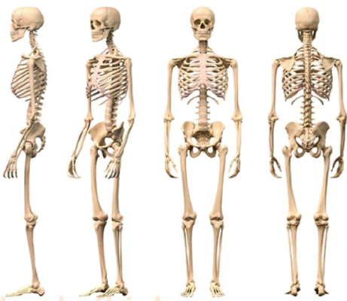

Slide 43
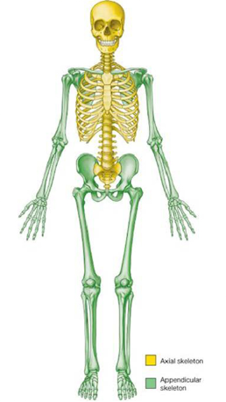
HUMAN SKELETAL SYSTEM
AXIAL SKELETON
(80 BONES)
APPENDICULAR SKELETON
(126 BONES)

Slide 44
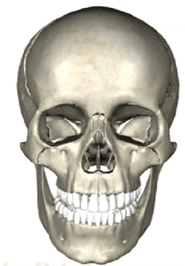
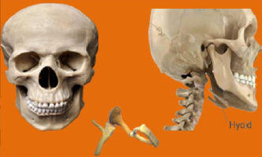
1. AXIAL SKELETON
1. Bones of Head (29 bones)
IT Includes

Slide 45
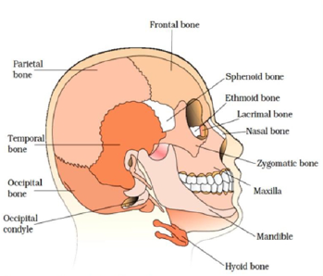
1. Bones of Head (29 bones)
A. SKULL (22)

Slide 46
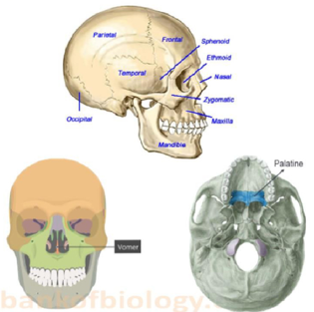
1. Bones of Head (29 bones)
A. SKULL (22)

Slide 47
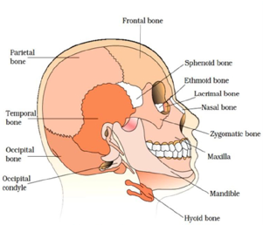
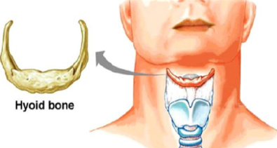
1. Bones of Head (29 bones)
B. HYOID BONE (1)
U-shaped bone found at the floor of buccal cavity

Slide 48
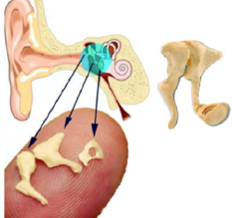
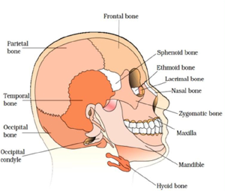
1. Bones of Head (29 bones)
C. EAR OSSICLES (3X2=6)
Maleus (2), Incus (2) and stapes (2)

Slide 49
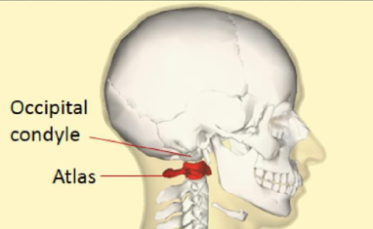
1. Bones of Head (29 bones)
The skull articulates with first vertebra (atlas) of vertebral column with the help of 2 occipital condyles (dicondylic skull).

Slide 50

2. VERTEBRAL COLUMN

Slide 51


Slide 52

3. STERNUM (BREAST BONE)
A Flat bone on the ventral midline of thorax.

Slide 53

4. RIBS (12 PAIRS)
3 TYPES

Slide 54


Slide 55

1. BONES OF FORE-LIMBS

Slide 56

2. BONES OF HIND-LIMBS

Slide 57

3. PECTORAL GIRDLES

Slide 58

4. PELVIC GIRDLES

Slide 59


Slide 60


Slide 61

1. FIBROUS JOINTS

Slide 62

2. CARTILAGINOUS JOINTS

Slide 63

3. SYNOVIAL JOINTS

Slide 64

TYPES OF SYNOVIAL JOINTS
EXAMPLES
Shoulder joint & hip joint
Knee joint, elbow joint etc.
Joints b/w atlas & axis
Joints b/w carpals.
Joints b/w carpal & metacarpal of thumb.
Ball & socket joint
Hinge joint
Pivot joint
Gliding joint
Saddle joint

Slide 65
DISORDERS OF MUSCULAR AND SKELETAL SYSTMES

Slide 66



MYASTHENIA GRAVIS
Auto immune disorder.
It affects neuromuscular junction.
It leads to fatigue, weakening & paralysis of skeletal muscles.

Slide 67


MUSCULAR DYSTROPHY
Progressive degeneration of skeletal muscles
Mostly due to genetic disorder.

Slide 68

TETANY
It is the rapid spasm in muscle due to low Ca²⁺ in body fluid.

Slide 69

ARTHRITIS
It is the inflammation of joints.

Slide 70

OSTEOPOROSIS
Age-related disorder characterized by decreased bone mass and increased chances of fractures.
Decreased level of estrogen is a common cause.

Slide 71

GOUT
It is the information of joints due to accumulation of uric acid crystals.

Slide 72
18. Out of X Pairs of ribs in humans, only ‘Y’ pairs are true ribs. Select the option that correctly represents values of X and Y and provides their explanation.
1. X – 12, Y – 7 true ribs are attached dorsally to vertebral column and ventrally to the sternum.
2. X = 12, Y = 5 true ribs are attached dorsally to vertebral column and sternum on the two ends.
3. X = 24, Y = 7 true ribs are dorsal attached to vertebral column but are free on ventral side.
4. X = 24, Y = 12 true ribs are dorsal attached to vertebral column but are free on ventral side.
19. True ribs are
1. Unicephalic 2. bicephalic
3. tricephalic 4. tetra cephalic

Slide 73
20. Vertebrochondral ribs are
1. 1st to 7th pairs of ribs
2. 8th, 9th and 10th pairs of ribs
3. 11th and 12th pairs of ribs
4. 9th and 11th pairs of ribs
21. Identify the longest bone among the following.
1. Patella 2. Clavicle 3. Femur 4. Ulna
22. Each half of pectoral girdle consists of
1. ilium and ischium 2. scapula and clavicle
3. femur and pubis 4. maxilla and mandible
23. The articulation of the lower limbs with the axial skeleton is done by
1. pectoral girdle 2. pelvic girdle
3. appendicular skeleton 4. occipital bone

Slide 74
24. Scapula, the large triangular bone is situated between
1. second rib and fifth rib
2. second rib and seventh rib
3. first rib and fifth rib
4. first rib and seventh rib
25. Joints refer to an articulation between
1. bones and tendons 2. two or more bones
3. bones and cartilage 4. both 2 and 3
26. Which of the following hormones can play a significant role in osteoporosis?
1. Estrogen and parathyroid hormone
2. Progesterone and Aldosterone
3. Aldosterone and Prolactin
4. Parathyroid hormone and Prolactin

Slide 75
27. Fill up the blanks (i - iv) and select the correct option. In human beings, total numbers of bones are (i) Axial skeleton comprises of (ii) bones. In axial skeleton, skull is made up of (iii) bones and vertebral column is made up of (iv) bones.
i ii iii iv
1. 260 78 20 30
2. 256 80 26 29
3. 206 80 29 26
4. 206 78 30 20

Slide 76

28. Identify the INCORRECTLY labelled part in the corresponding diagram.
1. Frontal bone 2. Temporal bone
3. Zygomatic bone 4. Occipital bone
29. Which of the following is NOT a facial bone?
1.Vomer 2. Zygomatic bone
3. Palatine 4. Ischium

Slide 77
30. Choose the correct option regarding number of bones present in following structures.
i. Skull ii. Lumbar vertebrae iii. Ribs iv. Phalanges
i ii iii iv
1. 29 12 14 5
2. 02 05 14 12
3. 29 07 24 14
4. 29 05 24 14
31. In human beings, the skeleton of the hand is made up
1. 7 tarsals, 5 metatarsals, 14 phalanges
2. 8 tarsals, 5 metatarsals, 14 phalanges
3. 8 carpals, 5 metacarpals, 14 phalanges
4. 7 carpals, 5 metacarpals, 14 phalanges

